Slide 1
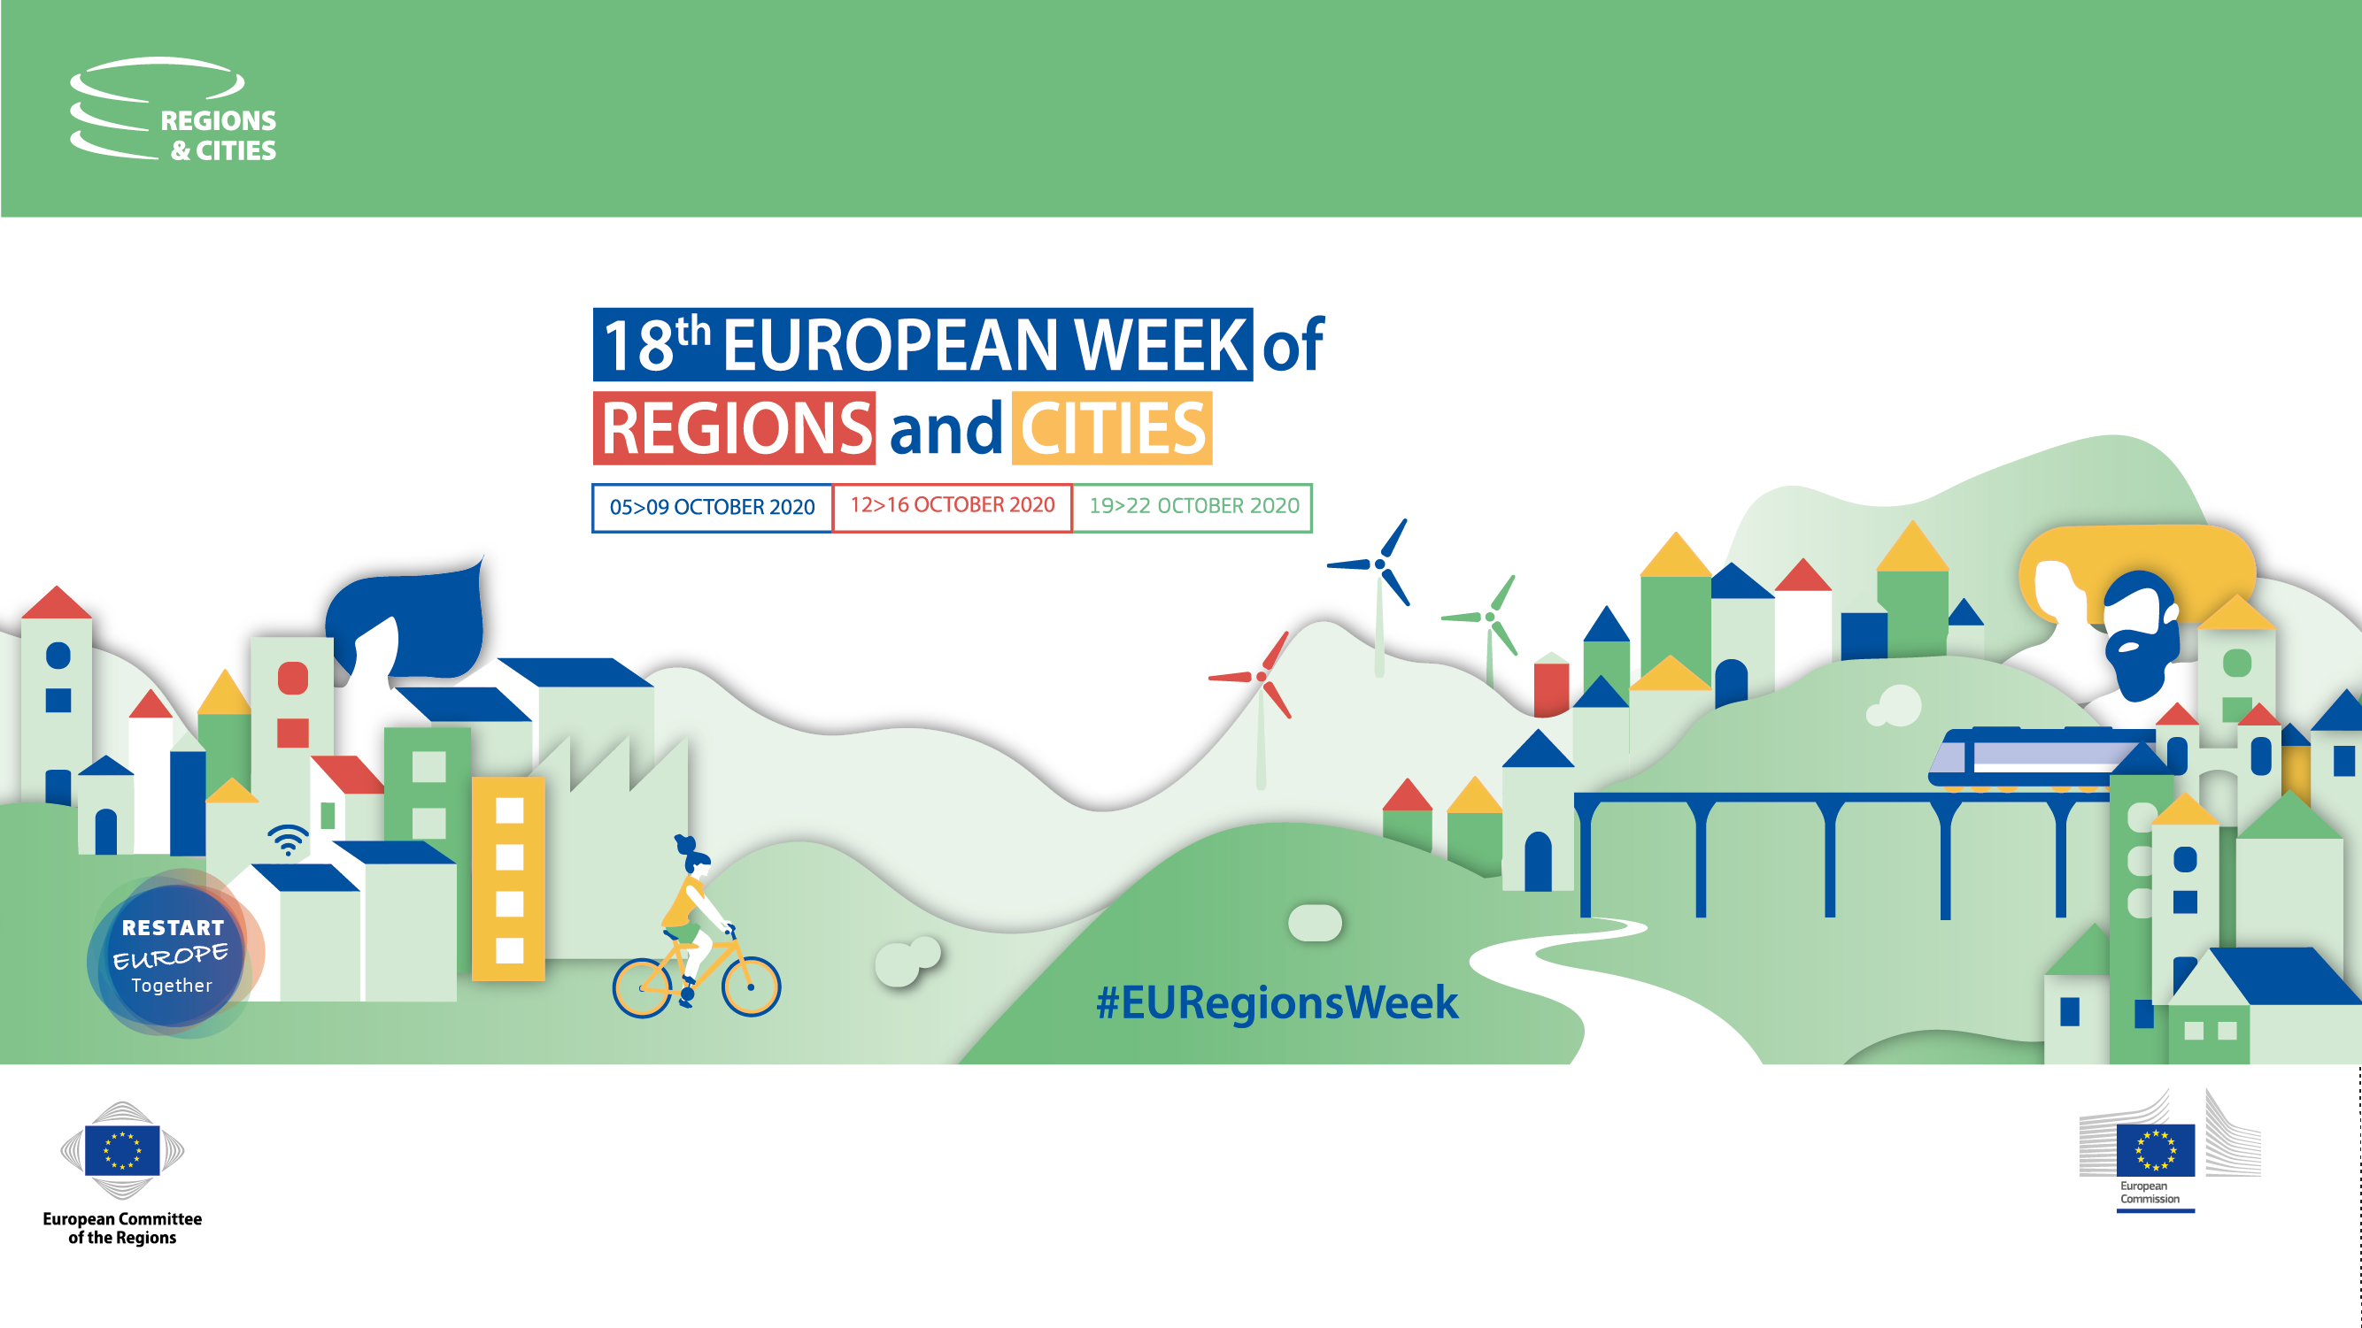


Slide 2
3 Counties Energy Agency
Paddy Phelan CEO
REGENERGY

Slide 3

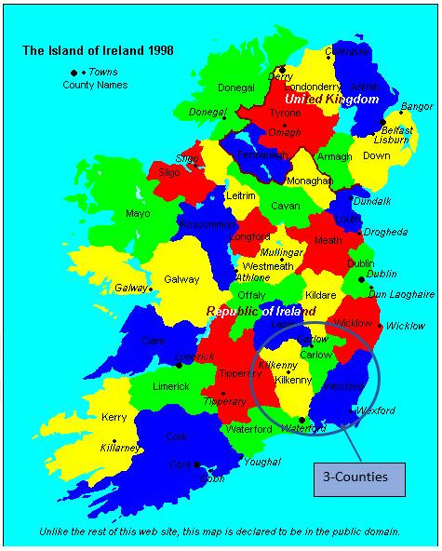

Slide 4
Current Status – Going Well!!
Where We Stand: In recent years there has been significant progress on a range of policy areas at the national level such as the Climate Action Plan and the Renewable Electricity Support Scheme (RESS). The new Programme for Government has set ambitious targets and has committed to an average 7% per annum reduction in overall GHG emissions from 2021 to 2030 and to achieve a net zero emissions by 2050. This will be copper fastened in the new Climate Action Bill October 2020. This is all in the backdrop of EU legislation such as REDII, the recast Electricity Directive (EU 2019/944) and the recast Renewable Energy Directive (EU 2018/2001). The Clean Energy Package (CEP) contains two definitions of energy communities: Citizen Energy Communities (CECs) and Renewable Energy Communities (RECs). Both these definitions are framed such that a legal entity to establish ownership, governance, commercial activity etc. is required to enable communities to participate in energy-related activities. Citizen participation is central, and they need to be key stakeholders in the transformation to clean energy and a low carbon society. Without community support and buy-in, developers and planners will meet huge opposition and encounter NIMBYism (Not In My Back Yard). Citizens and communities need to be supported both financially and technically and to be guided through the minefield of legislation and regulations around implementing energy projects. In Ireland there is no easy way to organise citizens who want to cooperate in an energy-sector for the betterment of their local communities. 3CEA, as regional actors and partners in the RegEnergy project, see themselves as trusted intermediaries between citizens and the institutions and having the capacity to leverage knowledge, expertise, finance, and innovation to achieve regional and national targets. 3CEA’s strategic plan has identified that an investment of €100m per annum is required across the 3-counties region by 2022 to reach 2020 targets.

Slide 5
REC - Definition
‘renewable energy community’ means a legal entity:
which, in accordance with the applicable national law, is based on open and voluntary participation, is autonomous, and is effectively controlled by shareholders or members that are located in the proximity of the renewable energy projects that are owned and developed by that legal entity;
the shareholders or members of which are natural persons, SMEs or local authorities, including municipalities;
the primary purpose of which is to provide environmental, economic or social community benefits for its shareholders or members or for the local areas where it operates, rather than financial profits;

Slide 6
Irish Adoption of RED II – Article 22
Ireland intend to transpose the RED II Directive into Irish law by June 30th 2021. Article 22 of the Directive, in particular deals with the rights of final customers to participate in Renewable Energy Communities and the obligations on member states to facilitate and remove barriers to same.
Moreover, the policy need for community energy has been reiterated in the new Programme for Government, "Our Shared Future", which underlines the importance of community participation in energy projects. Specifically, it commits to ensuring that community energy can play a role in reaching at least 70% renewable electricity target.

Slide 7
Renewable Electricity Support Scheme – Community Pot
RESS1 auction included a community preference category of circa 30 GWh.
Under EU law, RESS must be auction-based so as to encourage competition. Ireland sought and received EU state aid approval for a separate community category, an unprecedented decision by DG Competition based on the strong case built by DECC. This category has been developed specifically to allow communities to participate in RESS. Thus, the route to market barrier has been substantively addressed.
To participate in the category, a project had to be at least 51% community owned. Seven community projects have successfully come through the auction, two of which are 100% Community owned. It is the Minister’s stated intention that future participation in this category will be confined to projects fully owned by the Community.

Slide 8
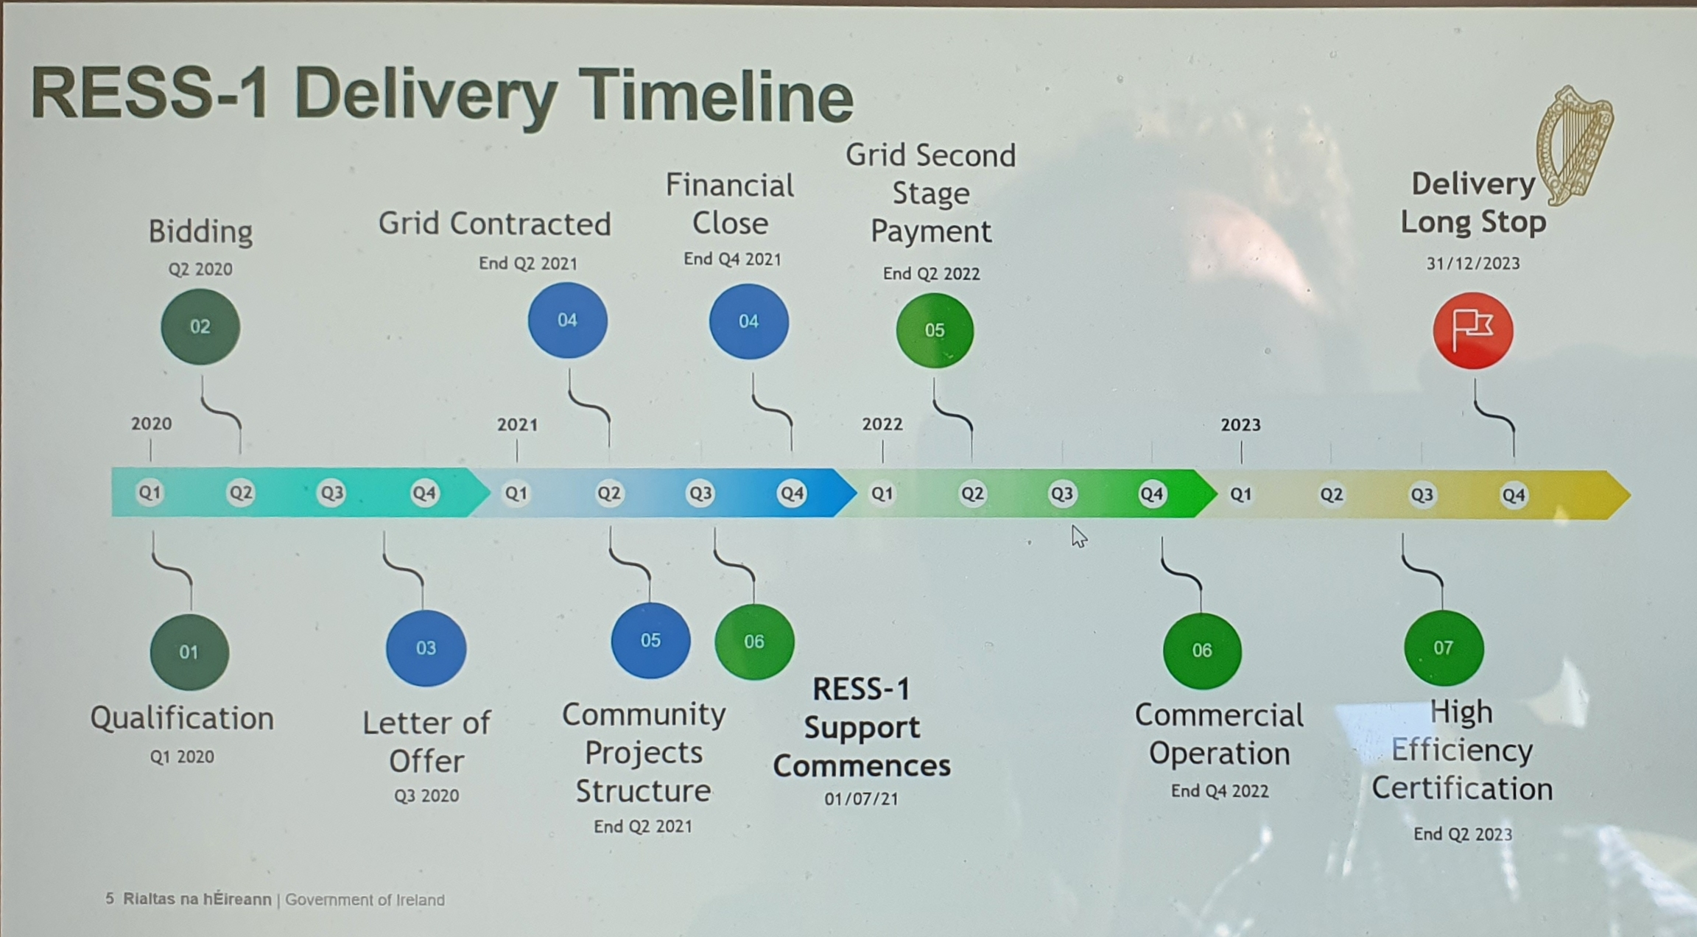

Slide 9
Renewable Electricity Support Scheme – Community Pot/Community Benefit Fund
All projects successful in the auction were also required to establish and administer a Community Benefit Fund of €2/MWh of Loss-Adjusted Metered Quantity. This fund will yield significant benefits for the local community. For RESS1 alone over the 15 year lifetime of the support the revenues to local communities will reach circa €50m, Payments from the Fund include near-neighbour benefits, of a minimum of €1,000 to those living within 1km, support for entities involved in the promotion of the UN Sustainable Development Goals and supports for local clubs, societies, and not-for-profit entities.
Going forward, the aim is to ensure delivery of circa 100 community electricity generation projects by 2030. In order to ensure an adequate pipeline of such projects, an enabling framework of capacity-building supports is being developed by the Department and the (SEAI. It includes information dissemination, trusted intermediary and adviser services, enabling grants and soft development loans. The SEAI has commenced assessing the next wave of community projects through the sustainable energy community network. The initial call has already identified 20 of the more mature projects for immediate support.

Slide 10
Regulator Update – Connection by DSO for community projects.
Already the CRU ECP1 decision published earlier this year has significantly addressed the grid barrier for communities, with its separate community track, expedited, flexible (application window did not close at end Sept) and simplified process, annual allocation of 15 connections and reduced application bureaucracy.
Speaking of CRU, they will have a leading implementation role around the communities requirements of the REDII and IMED.
They now plan a focused consultation and we are working closely with them in all of this.

Slide 11
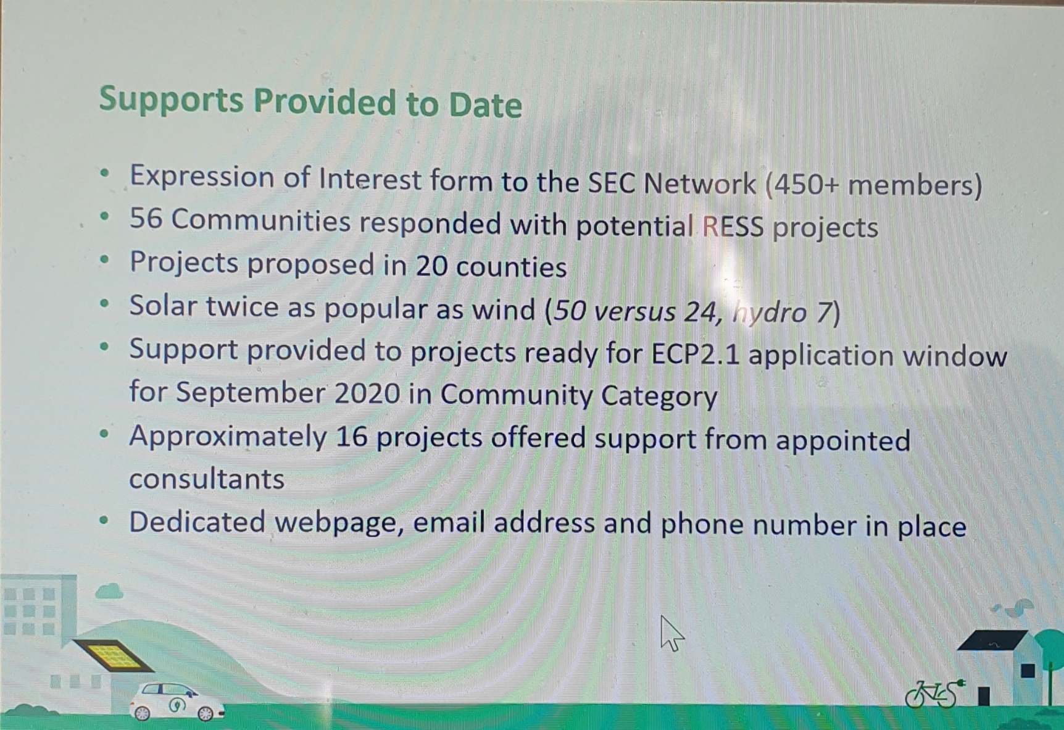
Needs assessment – Ireland of REC’s

Slide 12
Energy Communities
SEC – Supports from the SEAI to create and develop masterplan on Energy Efficiency www.seai.ie
Demand side assessment and supports to the communities working Energy Communities.
Not all will comply with the definition of the Article.
3cea working with REGENERGY project to do the County wide demand assessment for urban demand and strategies to deliver more renewable generation from rural regions to support the regions urban demands leading to
Jobs locally
Economic activity retained locally
De carbonising the region by 2030/50

Slide 13
Support Schemes Available in Ireland for Energy Coommunities
Sustainable Energy Authority (SEAI) support schemes
Sustainable Support for Renewable Heat (SSRH)
Excellence in Energy Efficient Design (Exceed)
Project Assistance Grant (PAG)
Communities Energy Grant (BEC)
National Government Department Supports:
Climate Action Fund (CAF)
Renewable Electricity Support Scheme (RESS)
Enterprise Ireland Commercial Case Feasibility Grant
Finance Options
Clan Credo – Community Climate Action programs
Community Finance Ireland
EU Directive / Commission Supports
Energy Efficiency Obligation Scheme (EEOS)
European Local Energy Assistance (ELENA)
European Regional Development Fund (ERDF)
EPA – Green Enterprise
Leader Programme
Rural Economic Development Zone (REDZ)
Targeted Agricultural Modernisation Schemes (TAMS)
Accelerated Capital Allowance (ACA)

Slide 14
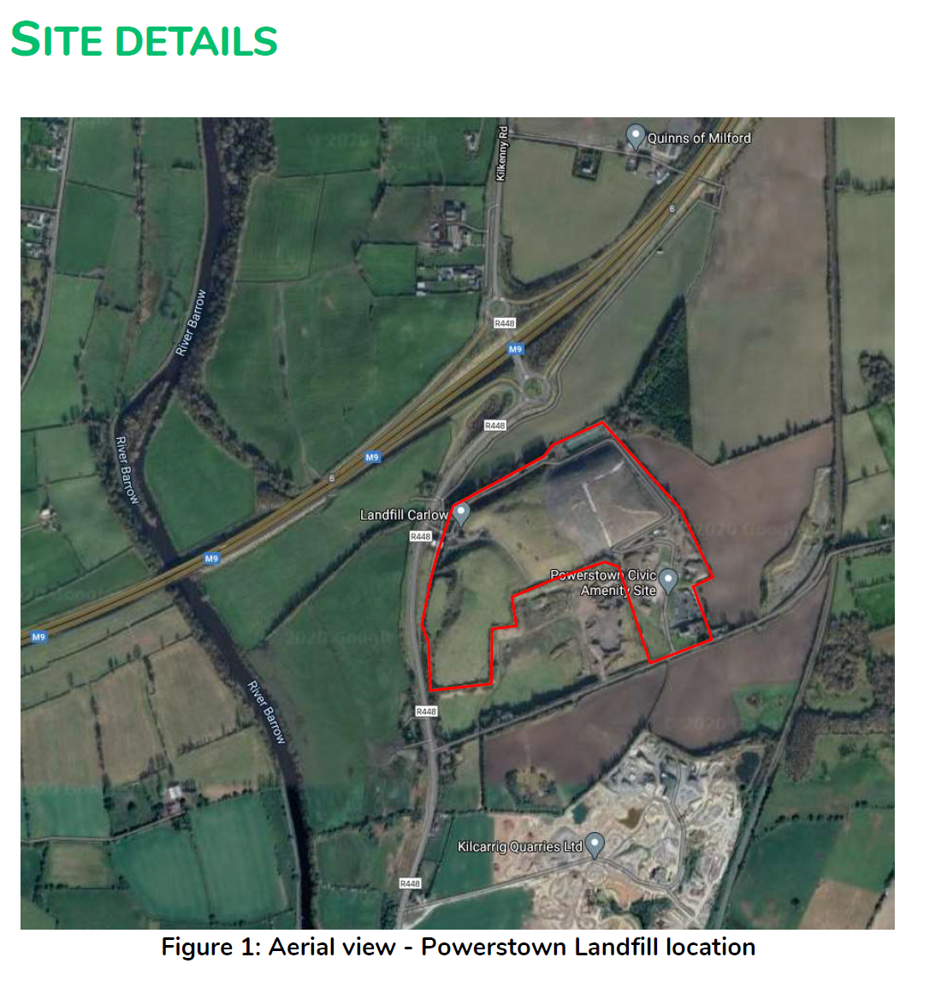
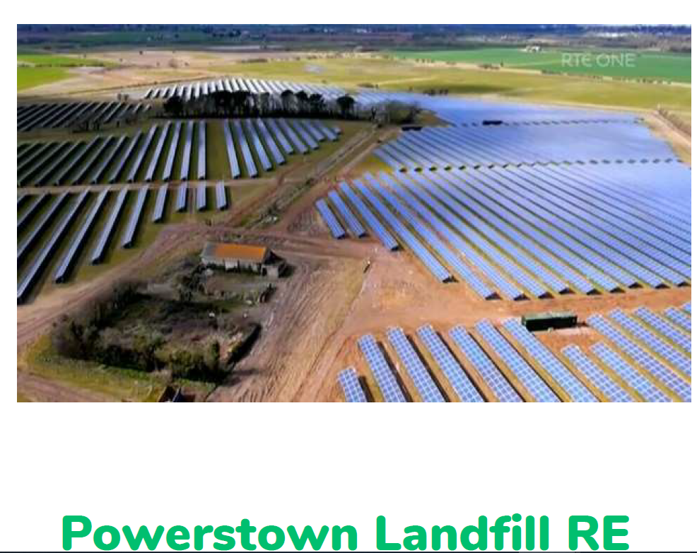
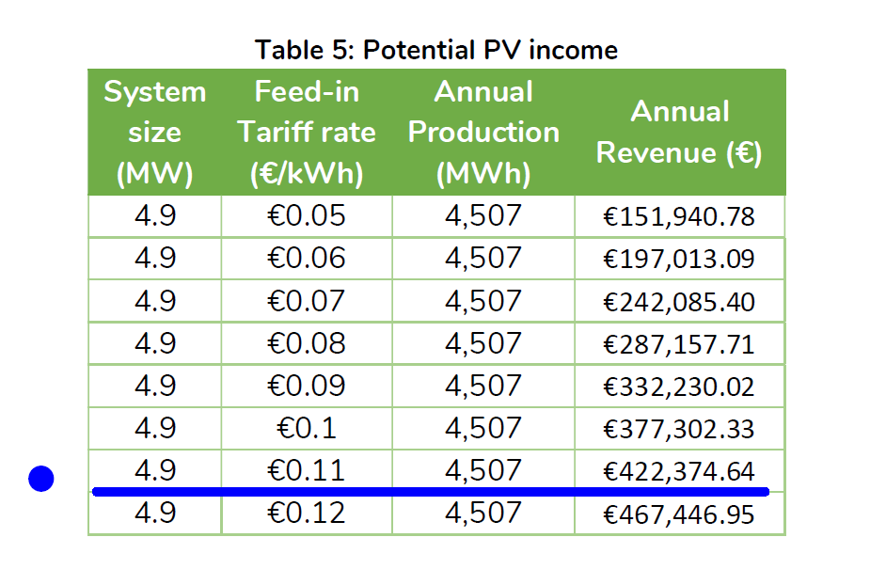
Case Study – REC LA led – 2022 Carlow Local Authority as an REC

Slide 15
3CEA need you to partner with us to continue the energy transition !!!!
Thank You
Visit our Website and subscribe to updates
3 Counties Energy Agency
Burrell Hall, St Kieran’s College, College Rd, Kilkenny
T: 056 779 0856
E: pphelan@3cea.ie W: www.3cea.ie
Twitter @3CEAgency LinkedIn : phelanp1

